Slide 1


Artificial and Computational Intelligence
AIMLCZG557
Contributors & Designers of document content : Cluster Course Faculty Team
M2 : : Problem Solving Agent using Search
BITS Pilani
Pilani Campus
Presented by
Dr. Srinivasa L.Chakravarthy
Chakri.ls@wilp.bits-Pilani.ac.in

Slide 2

Artificial and Computational Intelligence
Disclaimer and Acknowledgement
Few content for these slides may have been obtained from prescribed books and various other source on the Internet
I hereby acknowledge all the contributors for their material and inputs and gratefully acknowledge people others who made their course materials freely available online.
.I have provided source information wherever necessary
This is not a full fledged reading materials. Students are requested to refer to the textbook w.r.t detailed content of the presentation deck that is expected to be shared over e-learning portal - taxilla.
I have added and modified the content to suit the requirements of the class dynamics & live session’s lecture delivery flow for presentation
Slide Source / Preparation / Review:
From BITS Pilani WILP: Prof.Raja vadhana, Prof. Indumathi, Prof.Sangeetha
From BITS Oncampus & External : Mr.Santosh GSK

Slide 3

Course Plan
M1 | Introduction to AI
M2 | Problem Solving Agent using Search
M3 | Game Playing
M4 | Knowledge Representation using Logics
M5 | Probabilistic Representation and Reasoning
M6 | Reasoning over time
M7 | Ethics in AI

Slide 4
Learning Objective
At the end of this class , students Should be able to:
Design problem solving agents
Create search tree for given problem
Apply uninformed search algorithms to the given problem
Compare performance of given algorithms in terms of completeness, optimality, time and space complexity
Differentiate for which scenario appropriate uninformed search technique is suitable and justify.
Differentiate between Tree and Graph search

Slide 5

Problem Formulation
BITS Pilani, Deemed to be University under Section 3 of UGC Act, 1956

Slide 6

Searching for Solutions
Choosing the current state, testing possible successor function, expanding current state to generate new state is called Traversal. Choice of which state to expand – Search
Strategy
Search Strategy (under certainty)
Uninformed BFS, DFS, UCS IDS, DLS
Bi-Directional
Informed
Greedy Best First Search
A*
AO*

Slide 7

In(Arad)
Go(Sibiu)
Go(Timisoara)
Go(Zerind)
In(Sibiu)
In(Timisoara)
In(Zerind)
Go(Arad)
Go(Fagaras
Go(Oradea)
Go(Rimnicu Vilcea)
)
In(Arad)
In(Fagaras
In(Oradea)
In(Rimnicu Vilcea)
)
Leaf Nodes
(no children yet)

Slide 8

Uninformed Search – BFS & its Variant

Slide 9
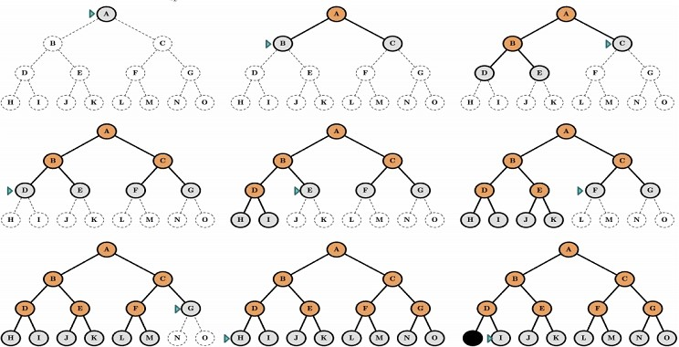
Breadth First Search (BFS)

Slide 10
BFS – Uninformed
1
1
75
70
125
100
5
2
3
4
2
125
75
125
50
50
3
4
5
4
5
5
3
4
100
(1)
(1 2) (1 3) (1 4)
TEST FAILED
:
:
(1 3) (1 4) (1 2 3) (1 2 4) (1 2 5)
(1 2 3) (1 2 4) (1 2 5) (1 3 4) (1 3 5 ) (1 4 5)
TEST PASSED
C(1-2-5) = 70 + 125 =195
Expanded : 4
Generated : 10
Max Queue Length : 6

Slide 11
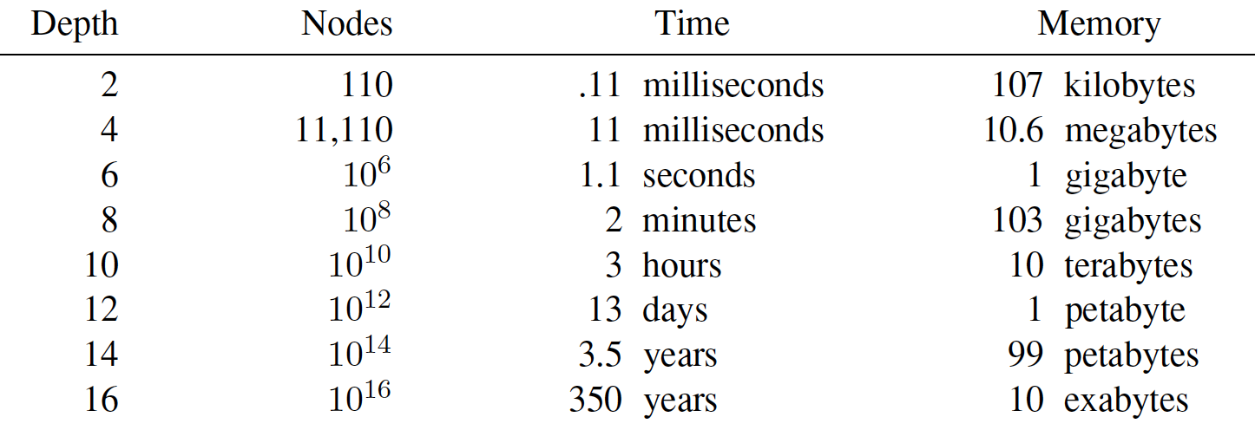
Breadth First Search – Evaluation
Why is Space Complexity a big problem? Imagine a problem with
branching factor b = 10
generates 1 million nodes/sec
Each node requires 1KB

Slide 12
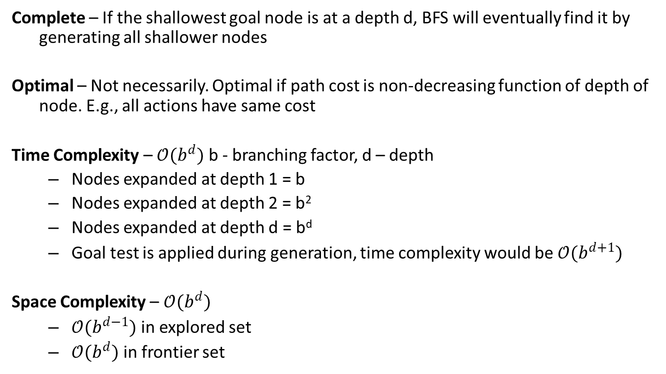
Breadth First Search – Evaluation

Slide 13
Uniform Cost Search
Instead of expanding the shallowest node, Uniform-Cost search expands the node n with the lowest path cost g(n)
Sorting the Frontier as a priority queue ordered by g(n)
Goal test is applied during expansion
The goal node if generated may not be on the optimal path
Find a better path to a node on the Frontier

Slide 14
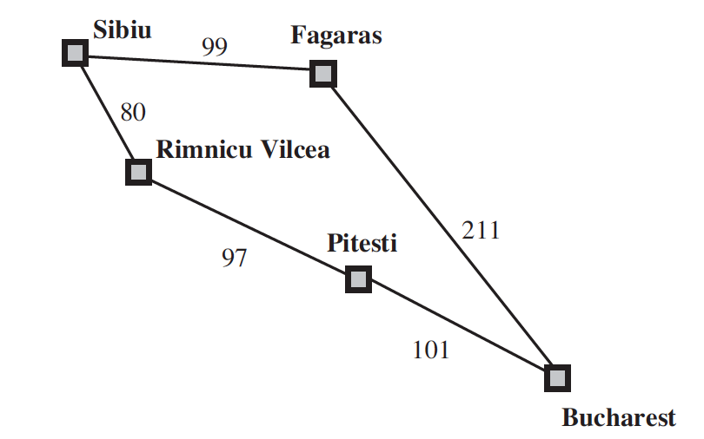
Uniform Cost Search
Current State: Sibiu
Frontier: []
Step: Expand Sibiu
Result: Generates (“Rimnicu Vilcea” 80)
(“Fagaras”, 99)
Add to Frontier
Initial State: Sibiu
Goal State: Bucharest

Slide 15
Uniform Cost Search
Current State: Sibiu
Frontier: [(“Rimnicu Vilcea” 80)
(“Fagaras”, 99)]
Step: Expand “Rimnicu Vilcea” (least cost)
Result: Generates (“Pitesti”, 177)
Add to Frontier
Initial State: Sibiu
Goal State: Bucharest

Slide 16
Uniform Cost Search
Current State: Rimnicu Vilcea (not a Goal state)
Frontier: [ (“Fagaras”, 99)
(“Pitesti”, 177)]
Step: Expand “Fagaras” (least cost)
Result: Generates (“Bucharest”, 310)
Add to Frontier
(It’s a Goal State but we won’t
test during generation)
Initial State: Sibiu
Goal State: Bucharest

Slide 17
Uniform Cost Search
Current State: Fagaras (not a goal state)
Frontier: [ (“Pitesti”, 177)
(“Bucharest”, 310)]
Step: Expand “Pitesti” (least cost)
Result: Generates (“Bucharest”, 278)
Replace in Frontier
(It’s a Goal State but we won’t
test during generation)
Initial State: Sibiu
Goal State: Bucharest

Slide 18
Uniform Cost Search
Current State: Pitesti (not a goal state)
Frontier: [ (“Bucharest”, 278)]
Step: Expand “Bucharest”
Result: No further generation
as Goal Test satisfied
Return Solution
Initial State: Sibiu
Goal State: Bucharest

Slide 19
UCS
1
1
75
2
4
3
70
125
100
5
2
125
4
5
125
3
5
4
5
75
50
50
3
4
100
4
5
5
(1)
(1 2 : 70) (1 4 : 100) (1 3 : 125)
TEST-F
(1 4 : 100) (1 2 3 :120)(1 3 : 125) (1 2 4 : 145) (1 2 5 : 195)
TEST-F
(1 2 3 :120)(1 3 : 125) (1 2 4 : 145) (1 4 5: 150)(1 2 5 : 195)
TEST-F
(1 3 : 125) (1 2 4 : 145) (1 4 5: 150) (1 2 3 4:170) (1 2 5 : 195) (1 2 3 5 : 245)
TEST-F
(1 2 4 : 145) (1 4 5: 150) (1 2 3 4:170) (1 2 5 : 195) (1 3 4 : 225) (1 2 3 5 : 245) (1 3 5 : 250)
TEST-F
(1 4 5: 150) (1 2 3 4:170) (1 2 4 5 : 195) (1 2 5 : 195) (1 3 4 : 225) (1 2 3 5 : 245) (1 3 5 : 250)
TEST - P

Slide 20
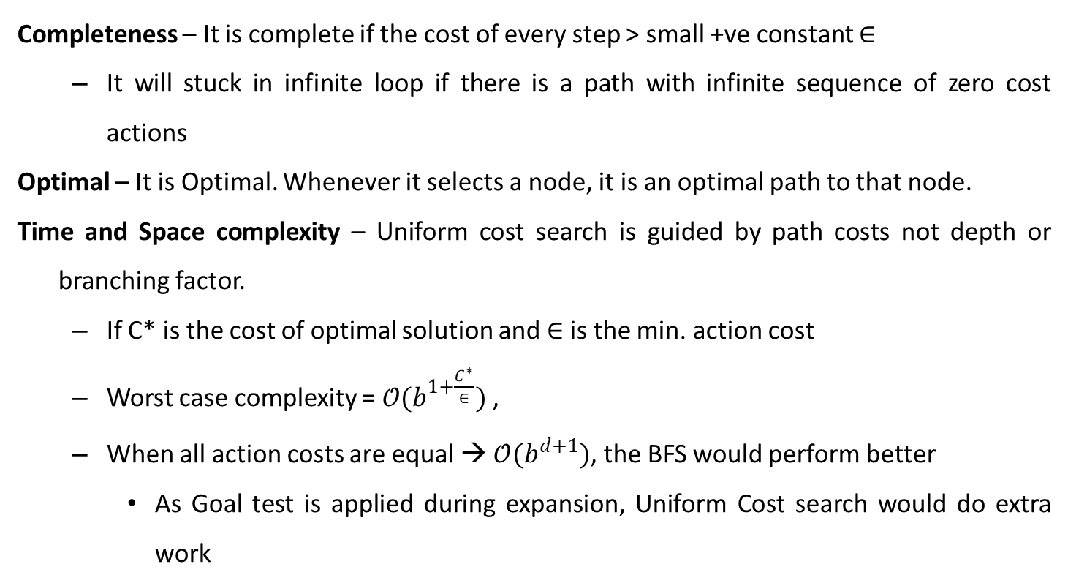
Uniform Cost Search – Evaluation

Slide 21
Uninformed Search – DFS & its Variant

Slide 22
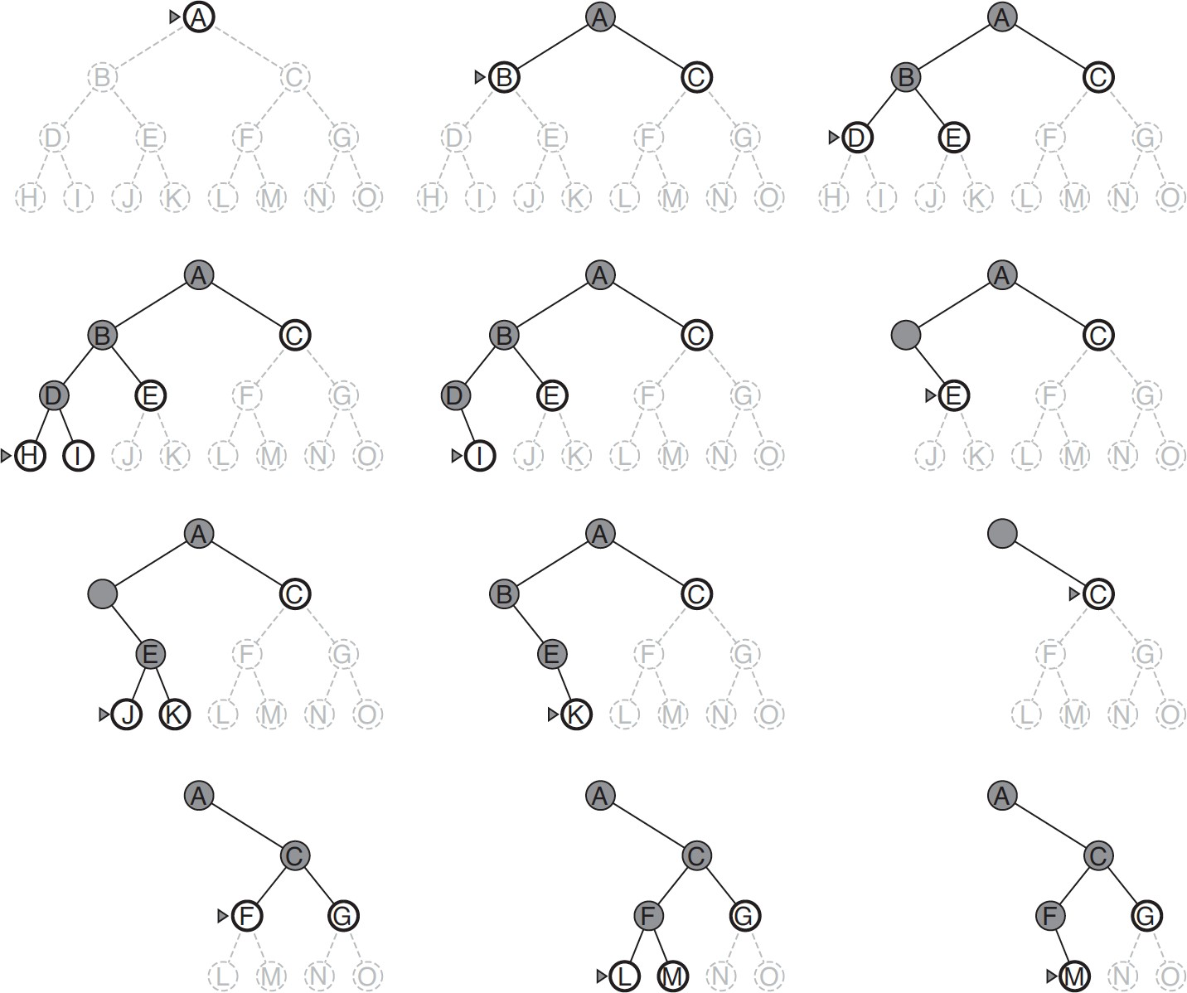
Depth First Search (DFS)

Slide 23
DFS – Uninformed
1
1
75
70
125
100
5
2
3
4
2
125
75
125
50
50
4
3
5
3
4
100
4
5
5
(1)
(1 2) (1 3) (1 4)
(1 2 3) (1 2 4) (1 2 5) (1 3) (1 4)
(1 2 3 4) (1 2 3 5) (1 2 4) (1 2 5) (1 3) (1 4)
(1 2 3 4 5) (1 2 3 5) (1 2 4) (1 2 5) (1 3) (1 4)
C(1-2-3-4-5) = 70 + 50 + 100 + 50 =270
Expanded : 4
Generated : 10
Max Queue Length : 6

Slide 24
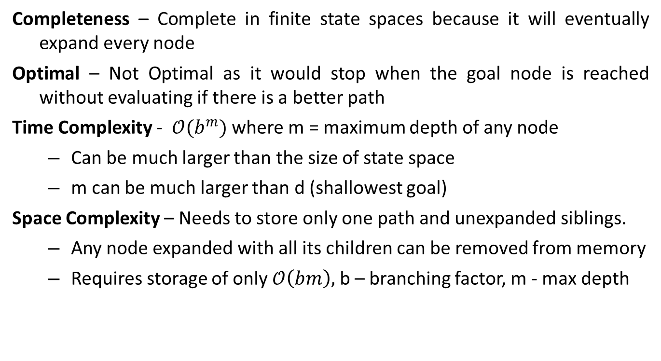
Depth First Search (DFS)

Slide 25
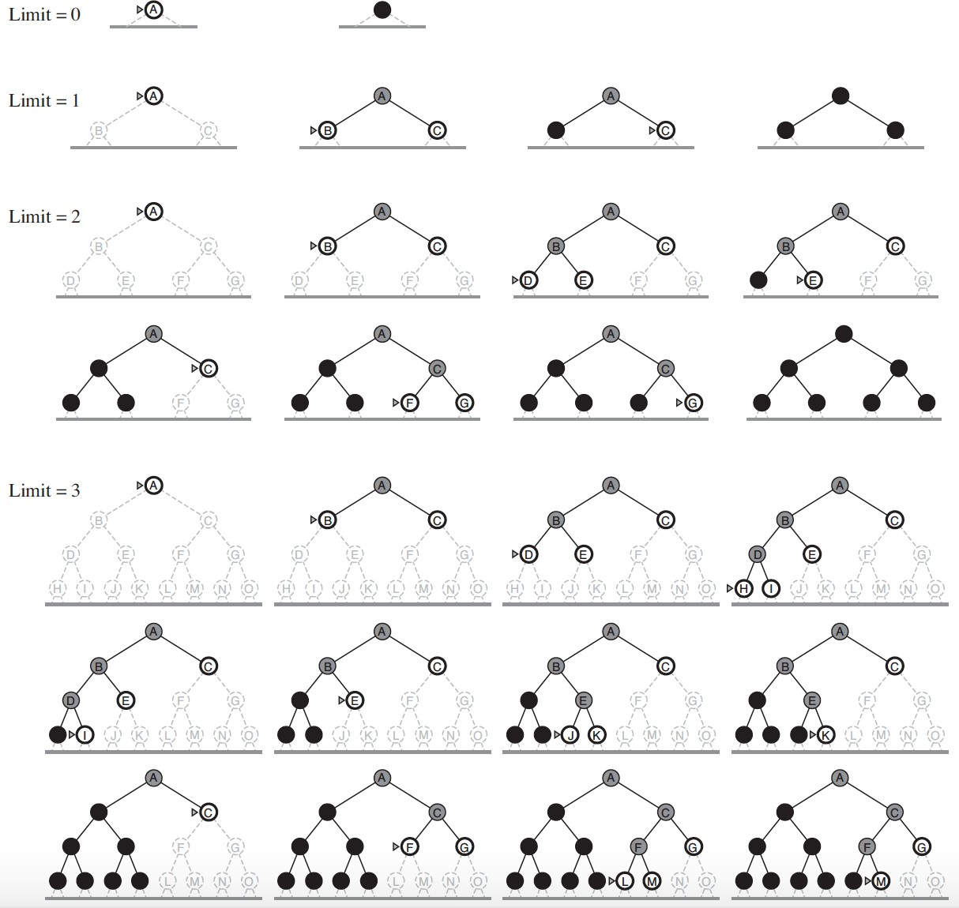
Iterative Deepening Depth First Search (IDS)

Slide 26

Search Algorithm – Uninformed Example
1
75
70
125
1
1
100
5
2
125
75
125
2
3
4
2
3
4
50
50
3
4
4
3 4 5 4 5
5
100
3
5
4
Can you guess which algorithm are these ?
5
5
(1)
(1 2) (1 3) (1 4) TEST FAILED
(1)
(1 2) (1 3) (1 4)
(1 2 3) (1 2 4) (1 2 5) (1 3) (1 4)
(1 2 3 4) (1 2 3 5) (1 2 4) (1 2 5) (1 3) (1 4)
(1 2 3 4 5) (1 2 3 5) (1 2 4) (1 2 5) (1 3) (1 4)
(1 3) (1 4) (1 2 3) (1 2 4) (1 2 5)
(1 2 3) (1 2 4) (1 2 5) (1 3 4) (1 3 5 ) (1 4 5) TEST PASSED
C(1-2-3-4-5) = 70 + 50 + 100 + 50 =270
Expanded : 4
Generated : 10
Max Queue Length : 6
C(1-2-5) = 70 + 125 =195
Expanded : 4
Generated : 10
Max Queue Length : 6

Slide 27
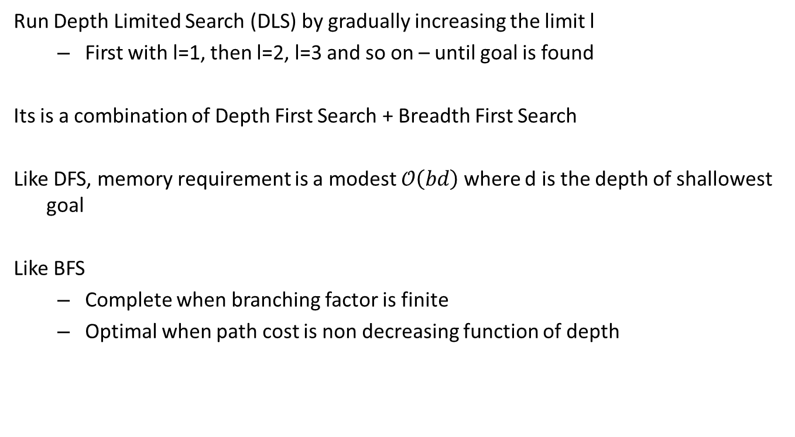
Iterative Deepening Depth First Search (IDS)

Slide 28
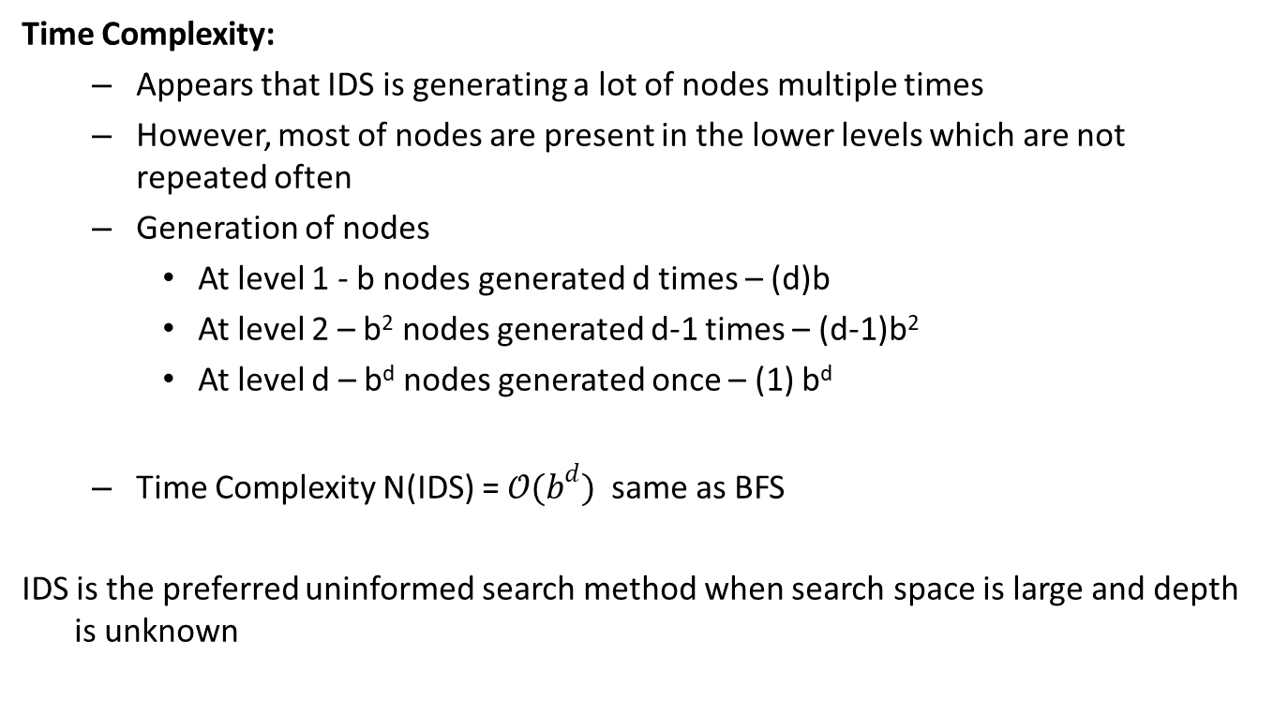
Iterative Deepening Depth First Search (IDS)

Slide 29
Application
Breadth First Search
Finding path in a graph (many solutions)
Finding the Bipartitions in a graph
Depth First Search
Find the Connectedness in a graph
Topological Sorting

Slide 30
Algorithm Tracing
Students must follow this in the exams for all the search algorithms in addition to the search tree constructions. The ordering of the Open Lists must be in consistent with the algorithm with a note on the justification of the order expected!
Iter | Open List / Frontiers / Fringes | Closed List | Goal Test
1. | (1) |  | Fail on (1)
2. | (1 3), (1 4), (1 2) | (1) | Fail on (1 3)

Slide 31

Terminologies – Learnt Today
Nodes
States
Frontier | Fringes
Search Strategy : LIFO | FIFO | Priority Queue
Performance Metrics
Completeness
Optimality
Time Complexity
Space Complexity
Algorithm Terminology
d Depth of a node
b Branching factor
n – nodes
l – level of a node
m – maximum
C* - Optimal Cost
E – least Cost
N –total node generated

Slide 32

Tree Search Vs Graph Search

Slide 33

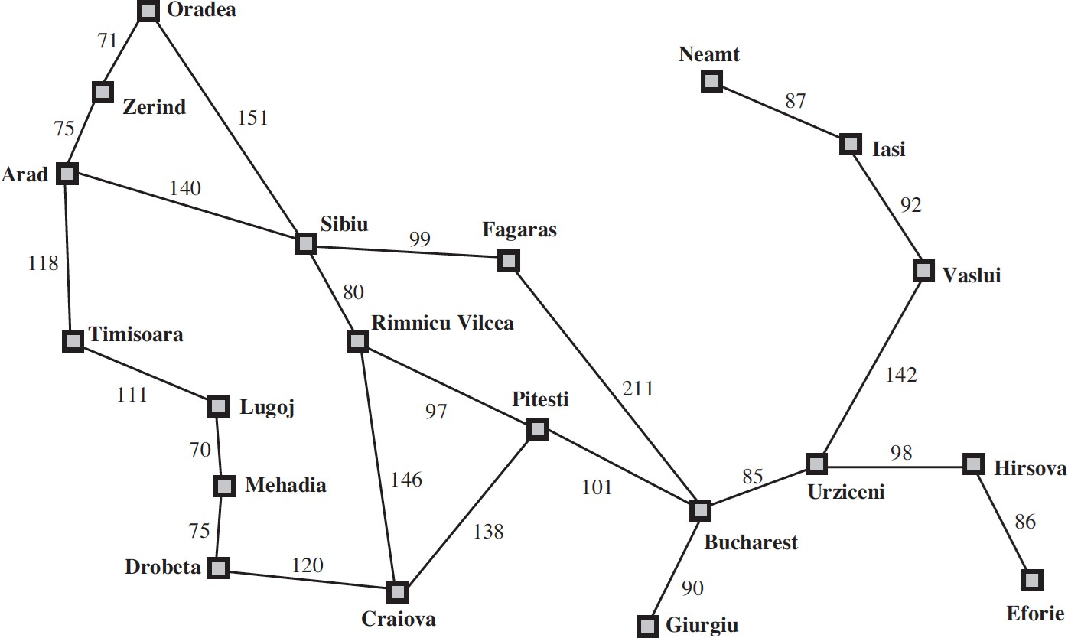

Slide 34

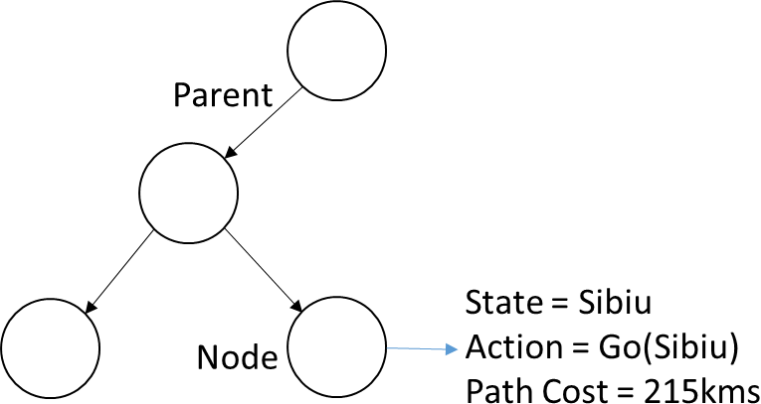
Search
Coding Aspects
For each node n of the tree,
n.STATE n.PARENT n.ACTION
: the state in the state space to which node corresponds
: the node in the search tree that generated this node
: the action that was applied to parent to generate the node
n.PATH-COST : the cost, denoted by g(n), of the path from initial state to node

Slide 35
Algorithm Tracing
Students must follow this in the exams for all the search algorithms in addition to the search tree constructions. The ordering of the Open Lists must be in consistent with the algorithm with a note on the justification of the order expected!
Iter | Open List / Frontiers / Fringes | Goal Test
1. | (1) | Fail on (1)
2. | (1 3), (1 4), (1 2) | Fail on (1 3)

Slide 36
Tree Search Algorithms
function Tree-Search (problem, strategy) returns a solution, or failure initialize the search tree using the initial state of problems loop do
if there are no candidate for expansion
then return failure
choose: leaf node for expansion according to strategy
if the node contains a goal state
then return the corresponding solution
else
Expand the node
Add the resulting nodes to the search tree
end

Slide 37
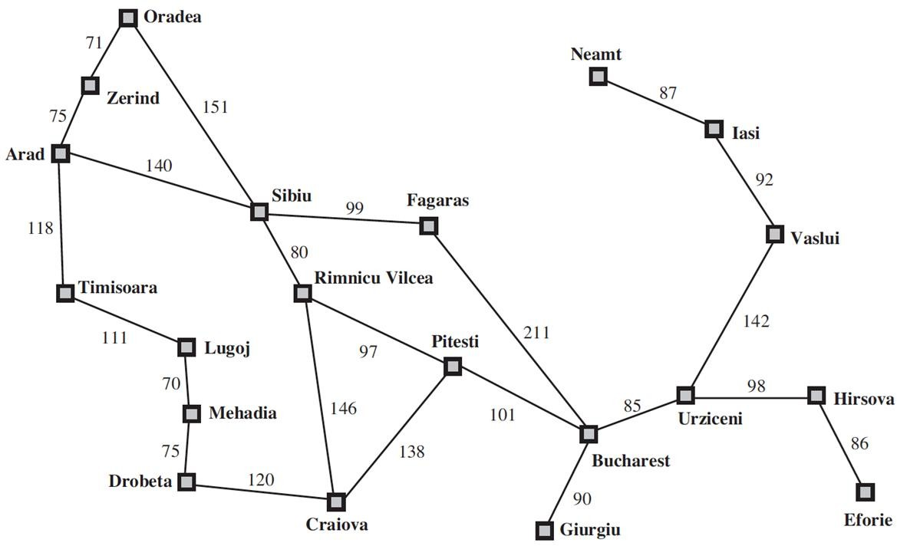
Tree Search Vs Graph Search Algorithms
Coding Aspects
Need:
Redundant Path Problem :More than one way to reach a state from another.
Infinite Loop Path Problem
Start : Arad Goal : Craiova

Slide 38
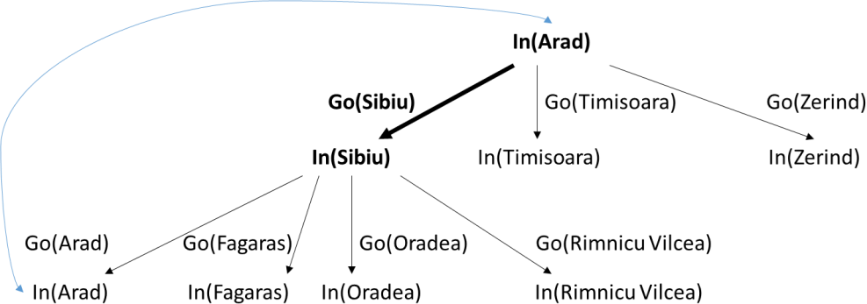
Tree Search Vs Graph Search Algorithms
Coding Aspects
Need:
Redundant Path Problem
Infinite Loop Path Problem: Repeated State generated by looped path existence.
Start : Arad Goal : Craiova

Slide 39
Algorithm Tracing
Students must follow this in the exams for all the search algorithms in addition to the search tree constructions. The ordering of the Open Lists must be in consistent with the algorithm with a note on the justification of the order expected!
Iter | Open List / Frontiers / Fringes | Closed List | Goal Test
1. | (1) |  | Fail on (1)
2. | (1 3), (1 4), (1 2) | (1) | Fail on (1 3)

Slide 40
Search
Coding Aspects
For each node n of the tree,
n.STATE n.PARENT n.ACTION
: the state in the state space to which node corresponds
: the node in the search tree that generated this node
: the action that was applied to parent to generate the node
n.PATH-COST : the cost, denoted by g(n), of the path from initial state to
node
n.VISITED
a
: the boolean indicating if the node is already visited and tested (or)
global SET of visited nodes

Slide 41
Tree Search Vs Graph Search Algorithms
Coding Aspects
Graph-Search Algorithm
Augments the Tree-Search algorithm to solve redundancy by keeping track of states that are already visited called as Explored Set. Only one copy of each state is maintained/stored.

Slide 42
Graph Search Algorithms
function Graph-Search (problem, fringe) returns a solution, or failure
initialize the search space using the initial state of problems memory to store
the visited fringe
closed 🡨 fringe 🡨 loop do
an empty set
Insert(Make-Node(Initial-State[problem]), fringe)
if fringe is empty
then return failure node🡨 Remove-Front(fringe)
if the node contains a goal state
then return the corresponding solution
else
if the node is not in closed ie., not visited yet Add the node to the closed set
Expand all the fringe of the node
Add all expanded sorted successors into the fringe
end

Slide 43

Required Reading: AIMA - Chapter #3: 3.1, 3.2, 3.3, 3.4
Next Class Plan :
Informed Search : GFBS & A*
Heuristic Design
Thank You for all your Attention
Note : Some of the slides are adopted from AIMA TB materials

